Slide 1


Slide 2


Welcome to our class 4A1
Teacher : Le Thi Thao

Slide 3






Slide 4
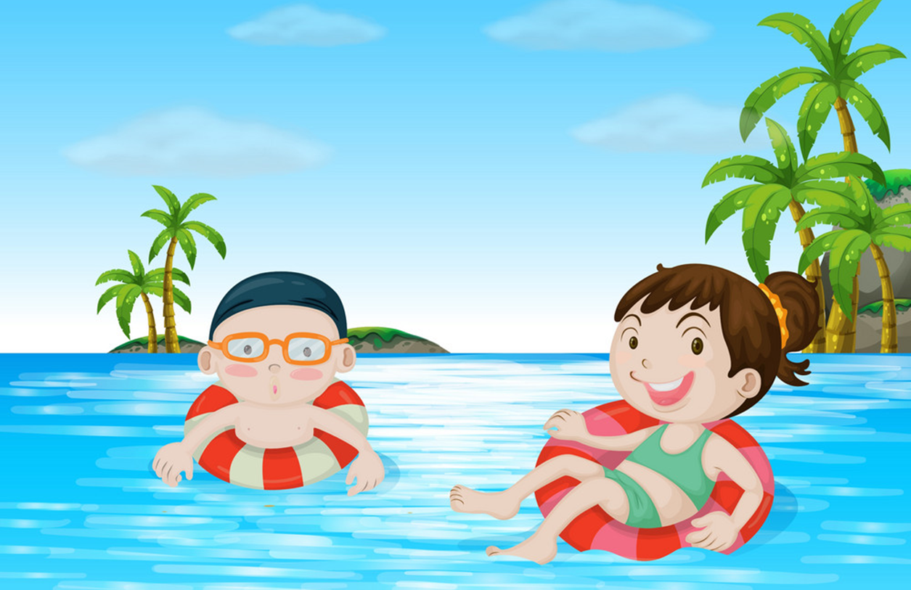



eat seafood
swim in the sea

Slide 5
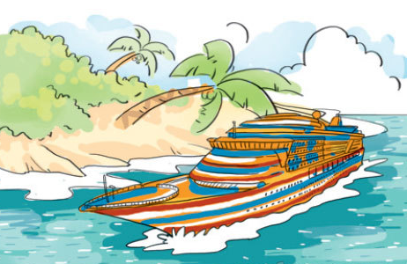

go on a boat cruise
stay in a hotel

Slide 6
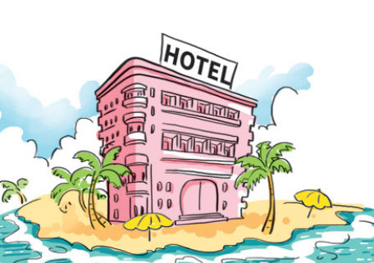
stay in a hotel
stay in a house

Slide 7

Where are you going this summer?
I’m going to Nha Trang.
I’m going to Ha Long Bay.

Slide 8
What are you going to do?
I’m going to eat seafood.
I’m going to swim in the sea.

Slide 9


Slide 10



Tuesday, May 9th, 2023
Unit 20:What are you going to do this summer?
Lesson 3: 4, 5, 6
G
O
R
O
O
O
D
A
T
E
N
F
N

Slide 11

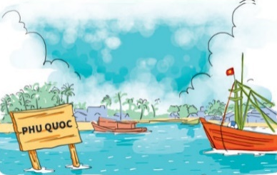

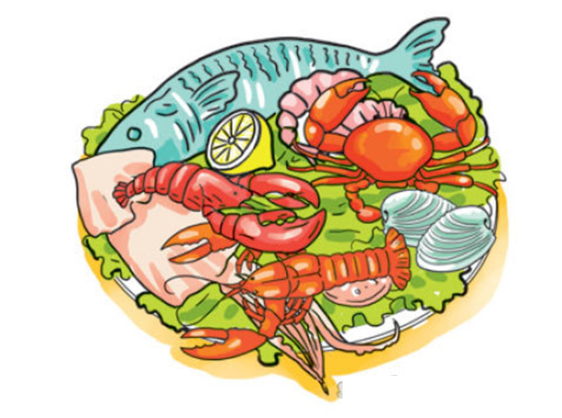

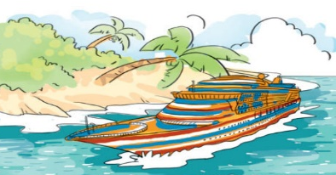
*Guess and tick.
1.Phong and his parents are going to…........
2. They are going to stay in a…….
3. In the morning, they are going to ….
4. In the afternoon, they are going to go on ….
5. In the evening, they are going to eat…….

Slide 12


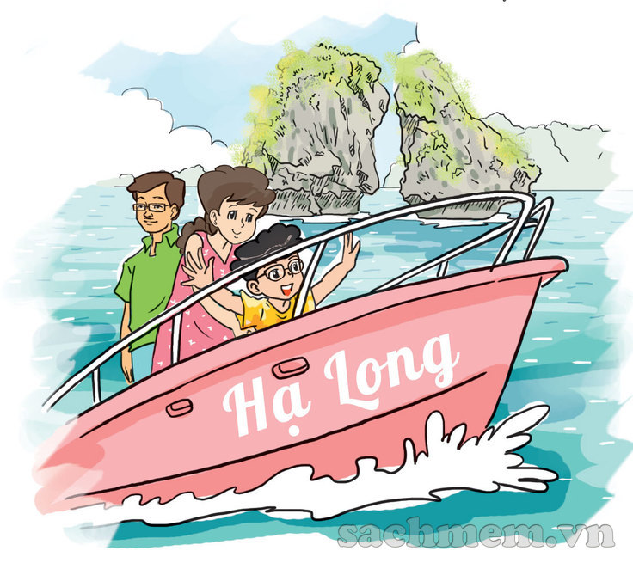
4. Read and complete.
My parents and I are going to have a holiday in Ha Long Bay next Saturday. We are going to stay in a nice hotel by the sea.
In the morning, we are going to swim in the sea. In the afternoon, we are going to have a boat cruise around the bay. We are going to have delicious seafood in Tuan Chau in the evening. We are going to have a lot of fun there!
1. They are going to have a holiday in _____________.
2. They are going to stay in ________________
3. In the morning, they are going to _______________ .
4. They are going to have _____________ around the bay.
5. They are going to eat _________________
Ha Long Bay
a hotel / a nice hotel.
swim in the sea
a boat cruise
seafood / delicious seafood .

Slide 13

5. Write about the plan for your summer holidays.
Where are you going?
I'm going to __________________________.
When are you going?
___________________________________.
Who are you going with?
___________________________________.
Where are you going to stay?
___________________________________.
What are you going to do?
___________________________________.

Slide 14


6. Project.
Work in pairs. Ask your partners about their plans for the summer holidays. Then tell the class about them.

Slide 15
*SUMMARY AND HOMEWORK
Review Vocabulary
Review pattern sentences
Where are you going this summer? – I’m going to…
What are you going to do ? - I’m going to…

Slide 16
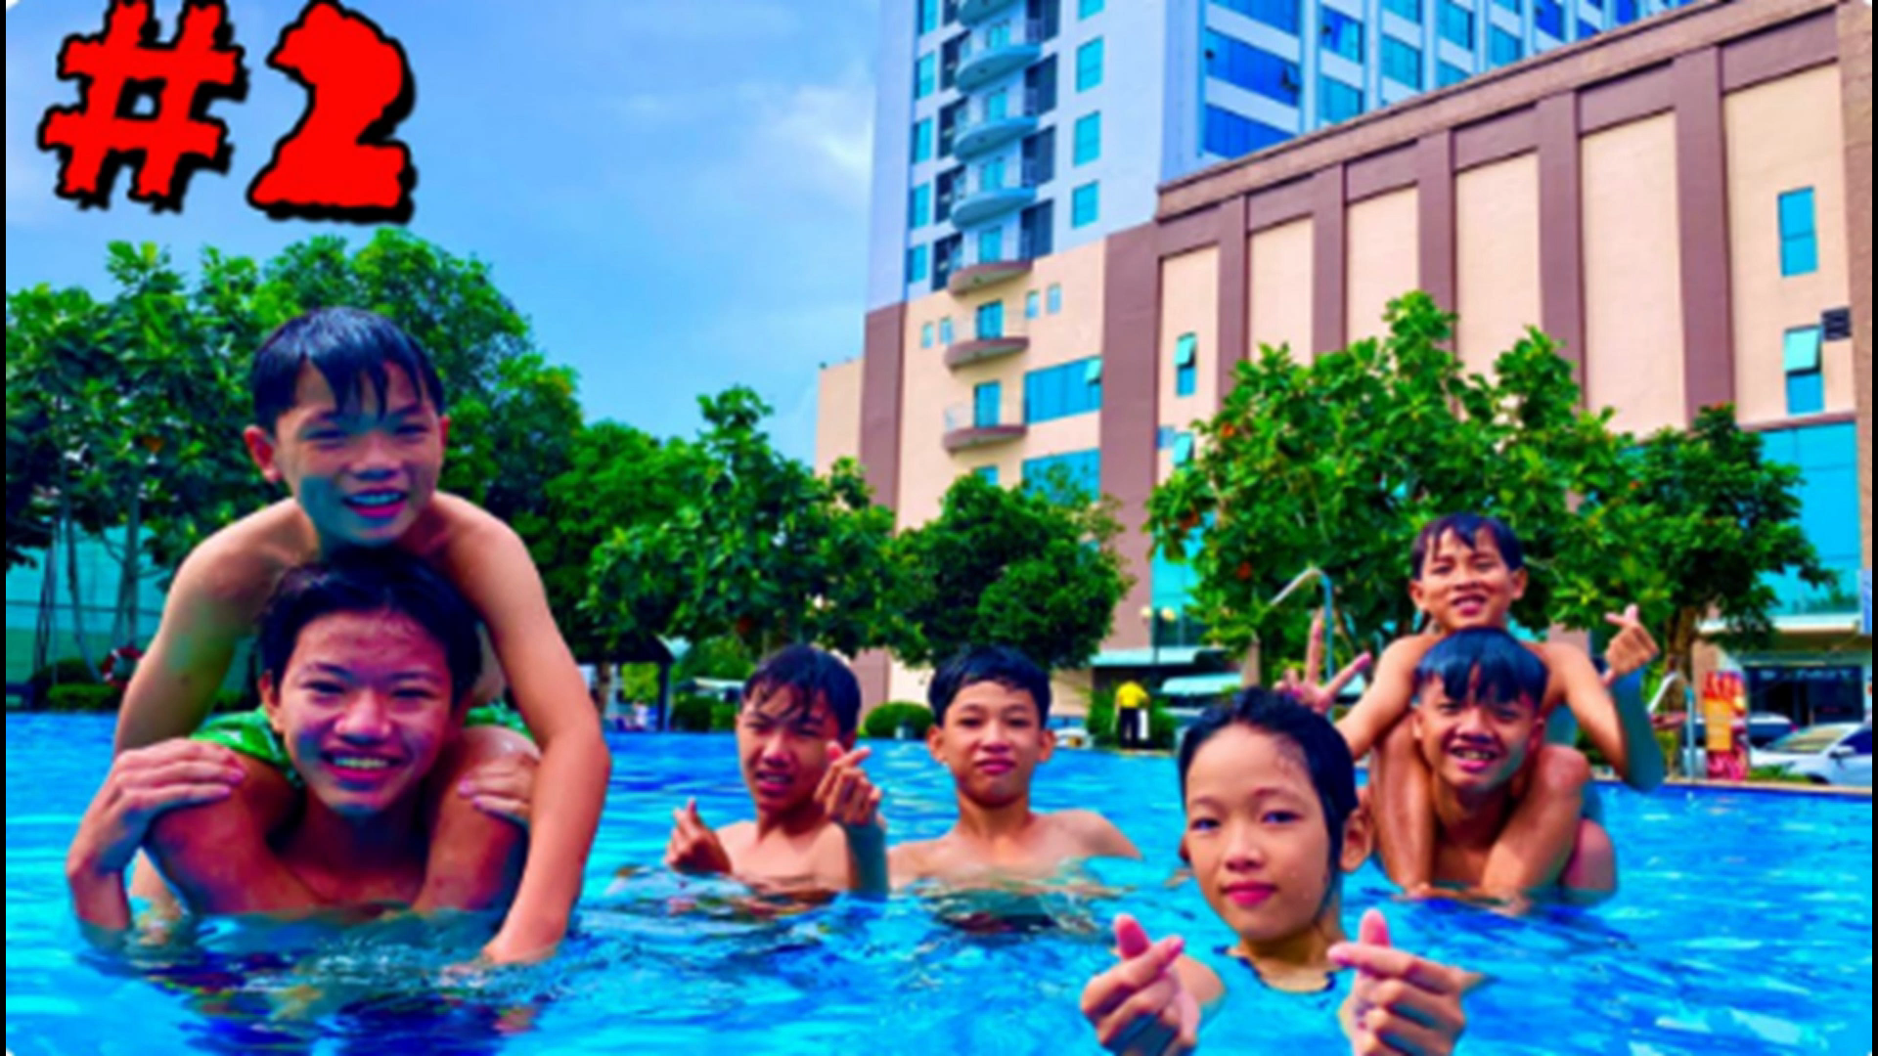

Slide 17


GOODBYE!
THANKS FOR YOUR ATTENTION!

